Slide 1

Credit Card Application Risk Assessment and Prediction
Anna Harvey
DSC 680 – Spring 2021
Bellevue University

Slide 2

Credit Card Defaults
Knowing if a customer is likely to default on a credit card benefits both the credit card companies and customers.

Slide 3
Credit card default prediction Credit card score cards and applications provide variables to assess potential risk.
Variables can include:
Income
Job status
Car/home ownership
Family size
Age
Occupation

Slide 4

Utilizing machine learning
Using a binary target variable to indicate whether a customer has defaulted or is at high risk for default provides the opportunity to use regression techniques to predict future defaults.

Slide 5
Data
Credit card application dataset
Collected demographic and financial information about potential customers
Credit record dataset
Describes payment history for existing customers with the credit card company

Slide 6
Credit card application dataset
Over 438,000 customers responding to 17 variables
Credit record dataset
45,985 customers total
47 duplicated IDs and 348,426 rows with identical information but different IDs
90,084 unique customers left after cleaning
Only 5426 customers that are shared between the two datasets

Slide 7
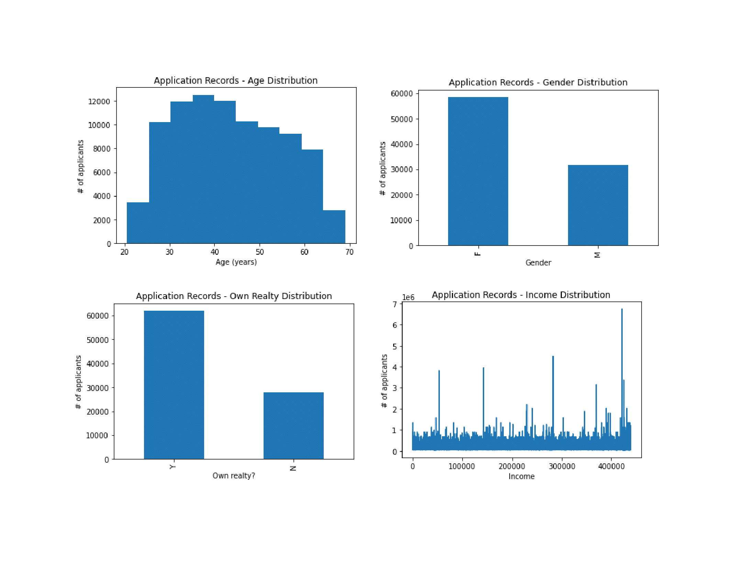
Variable distributions

Slide 8
Target Variable Creation
Income
Days employed
Income type
Months overdue on credit card payment (or no repayment)
Months where credit card was paid off
Months with no current loan
A feature was created for the common customers between the two datasets based off the following variables:

Slide 9
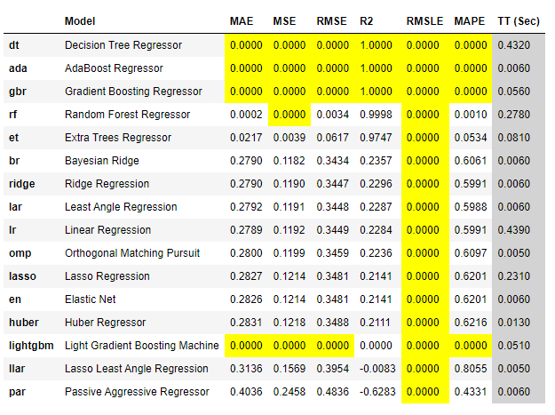
Regression Models with PyCaret

Slide 10
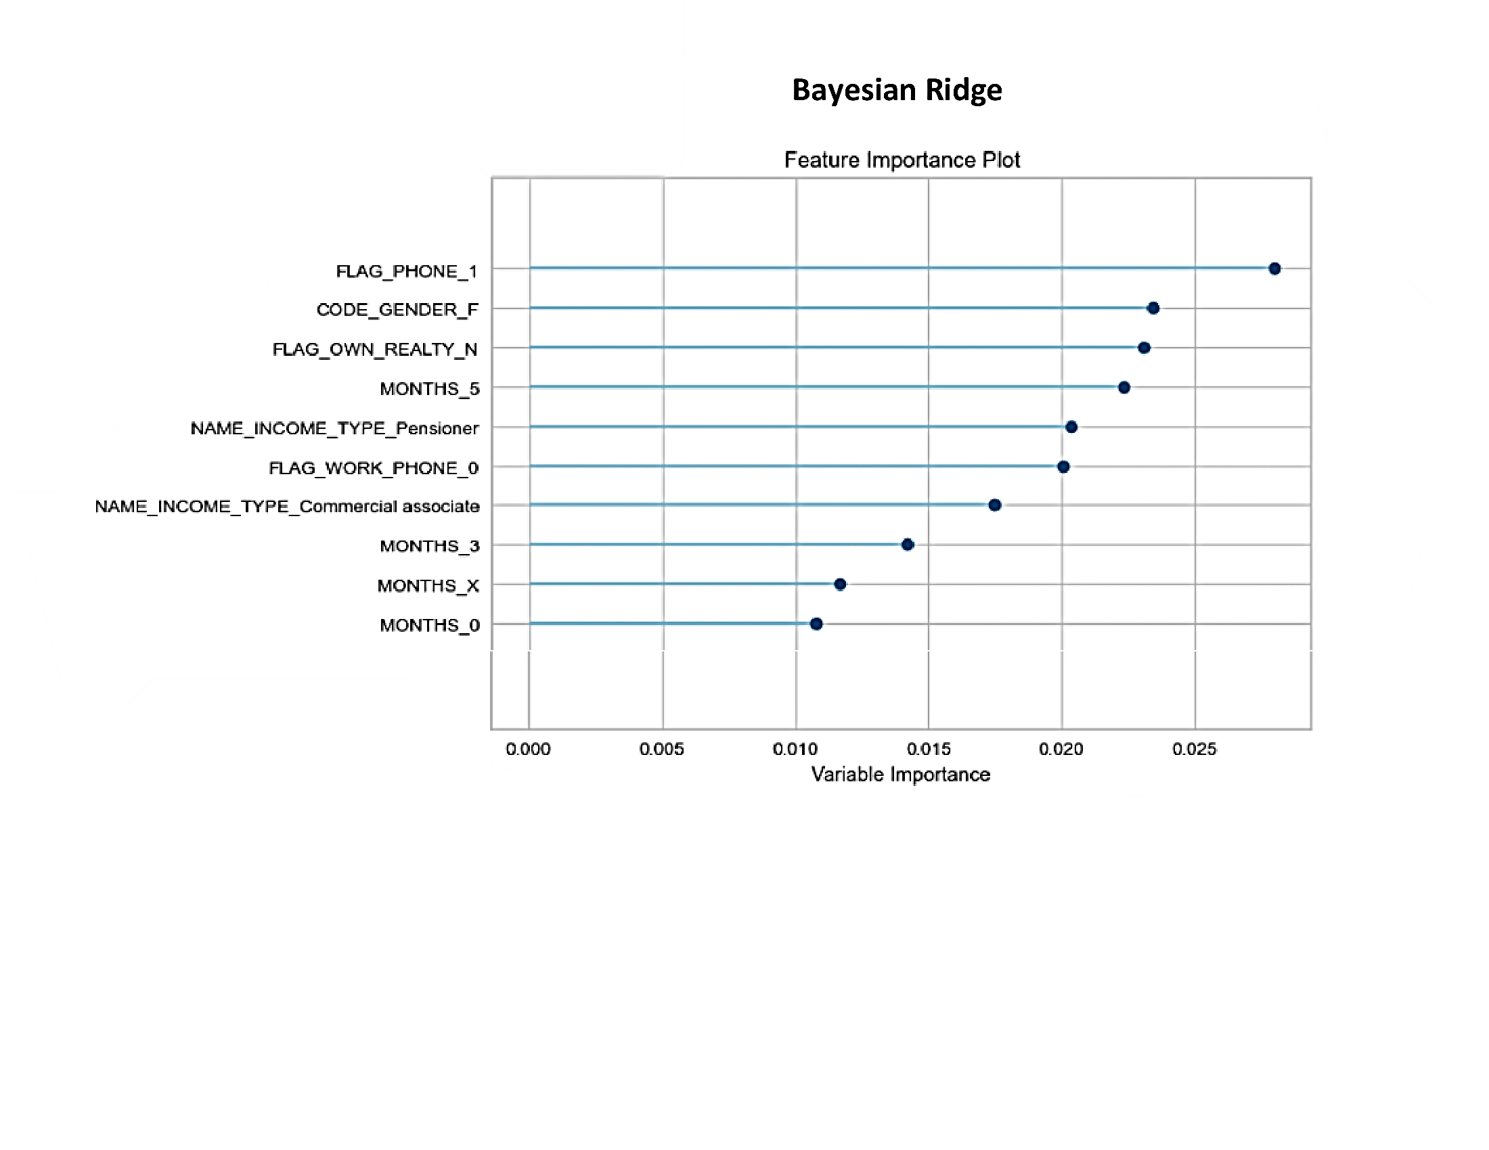
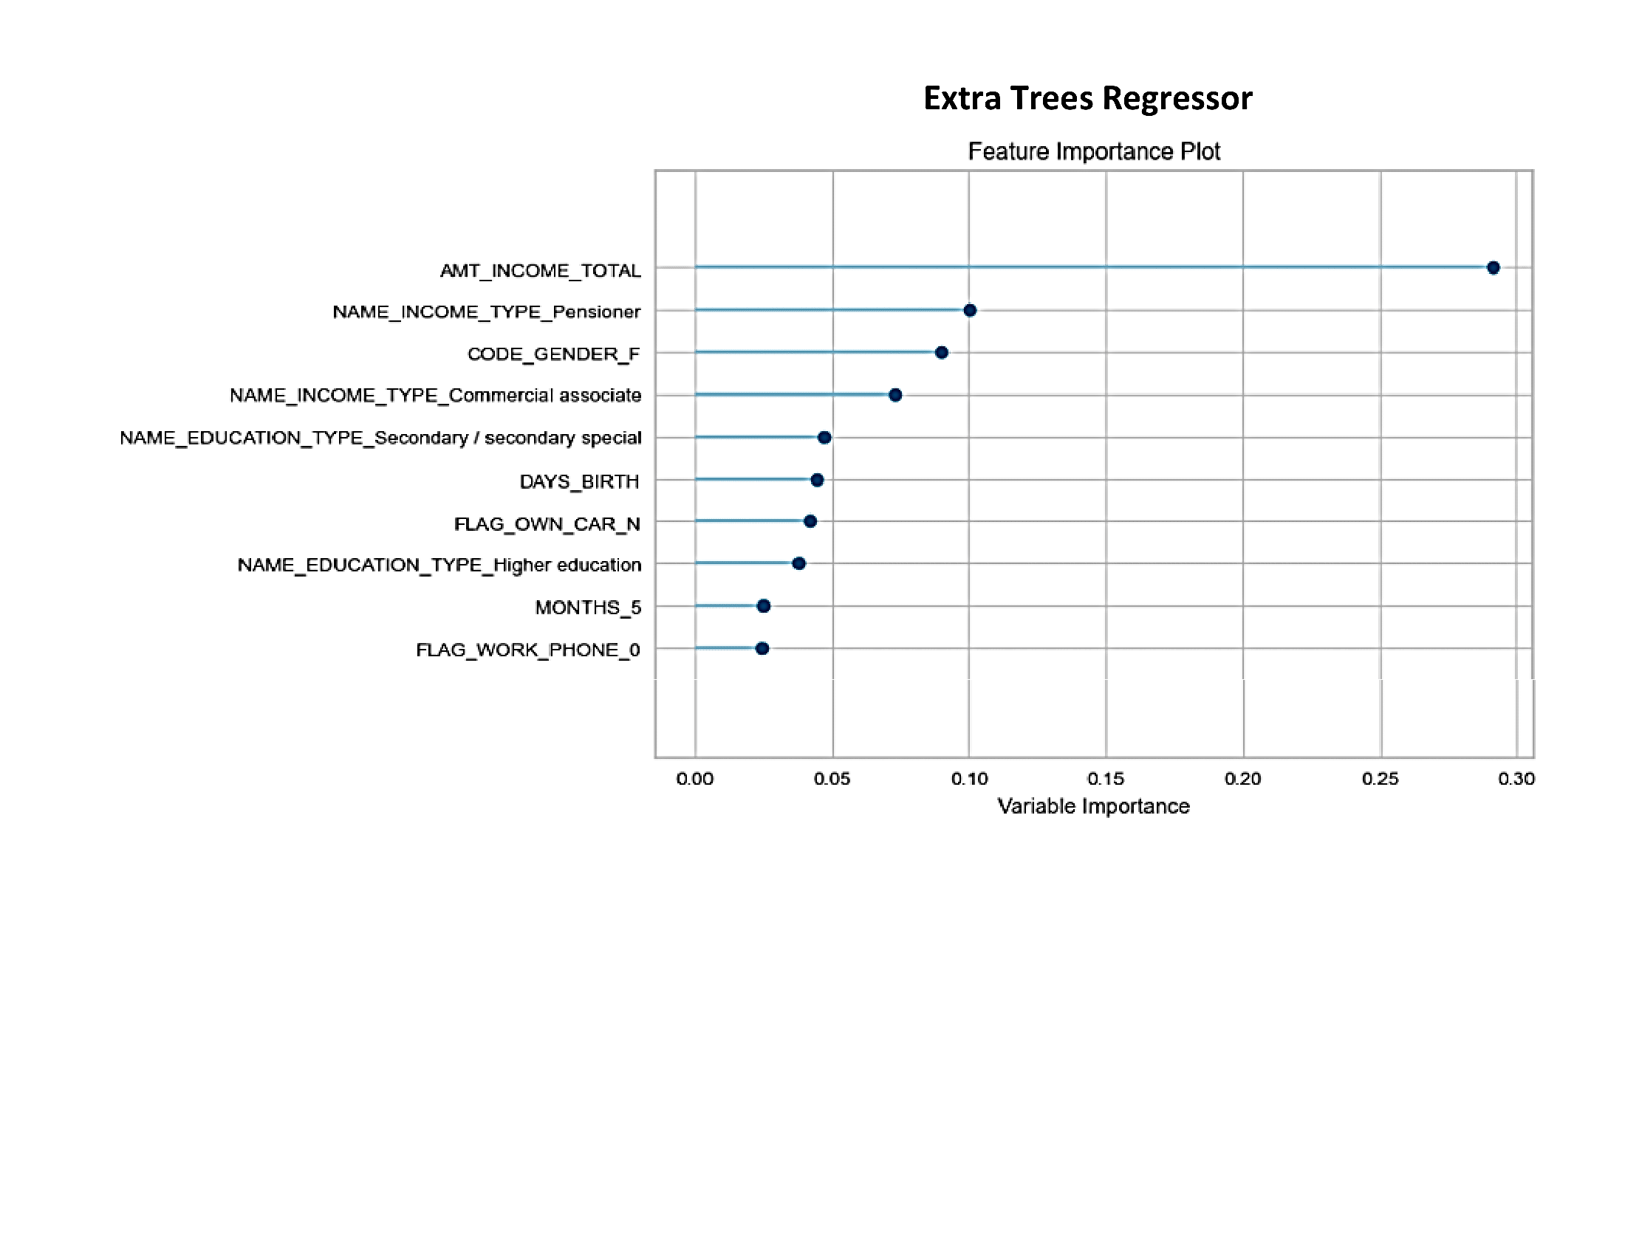
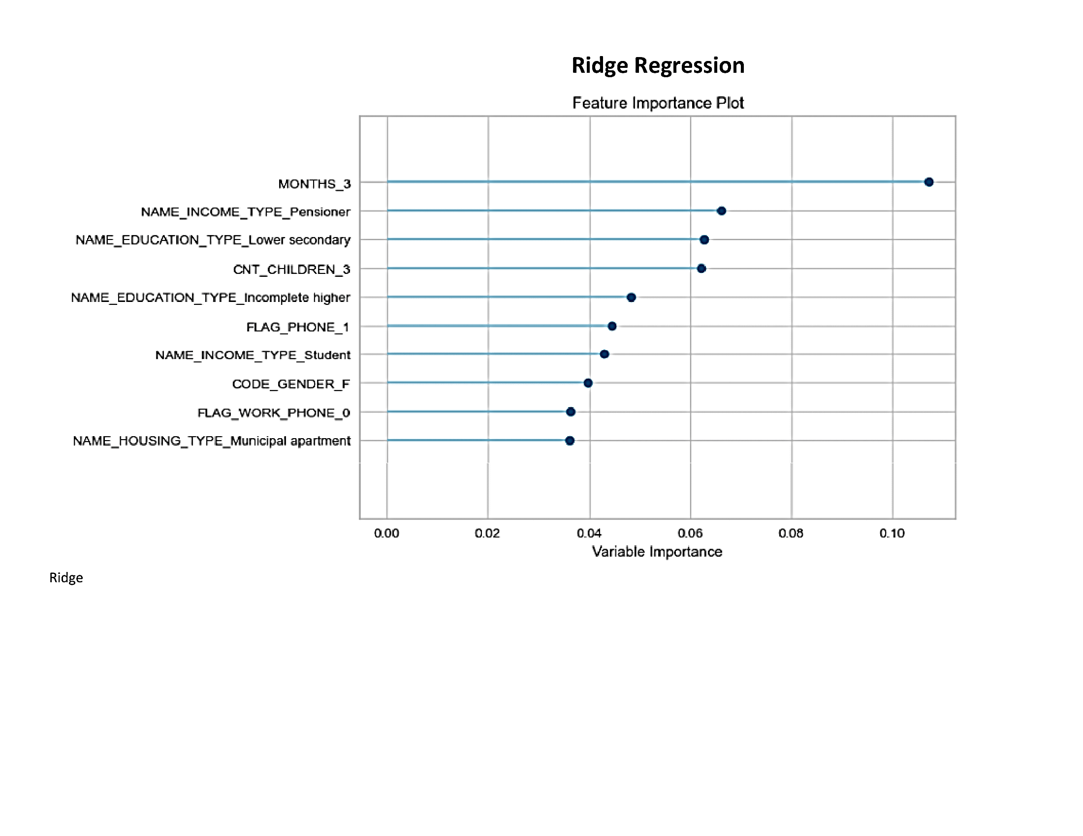
Regression Models with PyCaret
Top 10 features for each model

Slide 11
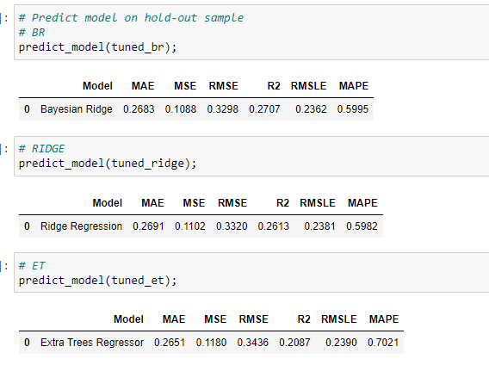
Regression Models with PyCaret
Low R2 scores can occur in datasets trying to predict human behavior.

Slide 12
Conclusions and Future Investigations
Low R2 scores may indicate wide variation in variables affecting outcomes
Target variable can be better refined based on domain knowledge
Incorporate more variables such as aggregated personal debt
Find larger customer database with less customer duplication error

